Slide 1
Daybreak University Annual Retreat May 13, 2025
MA and PhD in Counseling
with a Specialization in
Marriage and Family Therapy
Dr. Hye Jin Kim, LMFT, MFT Program Director

Slide 2
Agenda for Today
Welcome & Check-in
Program Updates & Accreditation Status
Program Mission
Program Goals
Student Learning Outcomes Aggregated Data
Survey Aggregated Data
Program Changes & Improvements
Graduation Achievement Data
Clinical Updates
Next Steps

Slide 3
Welcome & Check-in
Welcome to our Annual Spring Retreat
Check in
Communities of Interest (COI’s)
Administrators
Faculty(Core and Adjunct Faculty)
Program Clinical Supervisors
Students
Graduates
+ Staff

Slide 4
Program Updates & Accreditation Status
Multiple surveys consolidated into one Annual Survey.
2024 Fall COAMFTE Meeting Decision:
Daybreak university M.A. MFT Program received
the Full Accreditation given until 2029.
Daybreak University added Post Masters and Post Doctoral programs, BA in Psychology, as well as ESL program.

Slide 5
MA Program Mission and Program Goals (PG’s)
Mission: The mission of the MA Program in Counseling with a Specialization in Marriage and Family Therapy at Daybreak University is to prepare students to be culturally competent, ethical, evidence-based, self-observing, and systemic marriage and family therapists.
PG# 1 (Knowledge): The program will train students who demonstrate a foundational knowledge of marriage and family therapy theories, models, and interventions.
PG#2 (Practice): The program will train students who demonstrate a foundational competence to practice marriage and family therapy.
PG #3 (Diversity): The program will train students to practice MFT from a self-reflective and cultural competence foundation with a variety of diverse clients.
PG #4 (Ethics): The program will train students who demonstrate competencies related to legal and professional ethics, standards of practice, and personal awareness in their clinical work.
PG #5 (Research): The program will train family therapists who can consume and contribute to research in the field of marriage and family therapy.

Slide 6
MA Program Goals (PG’s), Student Learning Outcomes (SLO’s), Targets & Measure
PG# 1 (Knowledge): The program will train students who demonstrate a foundational knowledge of marriage and family therapy theories, models, and interventions.
(COAMFTE Developmental Competency Component: Knowledge of the field)
Curriculum Alignment:
1. CFT 6010: Foundations of Marriage
and Family Therapy
2. CFT 7000: Counseling and
Psychotherapeutic Theories and
Techniques: IPCST
SLO # 1:(Knowledge): Students will demonstrate comprehensive knowledge of systems theory concepts and MFT models and techniques.
At least 80% of students will pass Part I of the Comprehensive Exam
Aggregated Data for 2023, 2024: 100 % of students passed part 1 of the Comprehensive Exam
Target Met
Target, Measure, Data

Slide 7
MA Program Goals (PG’s), Student Learning Outcomes (SLO’s), Targets & Measure
PG#2 (Practice): The program will train students who demonstrate a foundational competence to practice marriage and family therapy.
(COAMFTE Developmental Competency Component: Practice)
Curriculum Alignment: CFT 7900: Practicum in Couples and Family Therapy
SLO #2 (Practice): Students will demonstrate competence in systemic/relational assessment, treatment planning, interventions, transfer, and termination.
Target, Measure, Data
Aggregated Data for 2023, 2024: 100 % of students passed part III of the Comprehensive Exam
At least 80% of students will pass Part III of the Comprehensive Exam.
Target Met

Slide 8
MA Program Goals (PG’s), Student Learning Outcomes (SLO’s), Targets & Measure
SLO #3. (Diversity): Students will demonstrate human diversity and practice culturally-sensitive analysis and critical self-awareness when working with a diversity of individuals, couples, and families.
Target, Measure, & Data
Aggregated Data for 2023, 2024: 100 % of students passed part III of the Comprehensive Exam
At least 80% of students will pass Part II of the Comprehensive Exam.
Target Met
PG#3 (Diversity): The program will train students to practice MFT from a self-reflective and cultural competence foundation with a variety of diverse clients
(COAMFTE Developmental Competency Component: Diversity)
Curriculum Alignment:
CFT 6300: Diversity and Multicultural
Counseling

Slide 9
MA Program Goals (PG’s), Student Learning Outcomes (SLO’s), Targets & Measure
SLO #4: (Ethics): Students will demonstrate ethical decision-making, case management, professionalism, and self-awareness in clinical practice
At least 80% of students will score a B or higher in the main assignment in the CFT 6600: Law, Professional Ethics, and Community Practice and Teletherapy course.
Aggregated Data for 2023, 2024: 100 % of students score a B or higher in the main assignment in the CFT 6600.
Target, Measure, & Data
Target Met
PG#4 (Ethics): The program will train students who demonstrate competencies related to legal and professional ethics, standards of practice, and personal awareness in their clinical work.
(COAMFTE Developmental Competency Component: Ethics)
Curriculum Alignment:
CFT 6600: Law, Professional Ethics,
and Community Practice and
Teletherapy

Slide 10
MA Program Goals (PG’s), Student Learning Outcomes (SLO’s), Targets & Measure
SLO #5: (Research): Students will be able to read and critically evaluate research for evidence - based application in the practice of marriage and family therapy.
Target, Measure, & Data
At least 80% of students will pass Part IV of the Comprehensive Exam.
Aggregated Data for 2023, 2024: 100 % of students passed Part IV of the Comprehensive Exam.
Target Met
PG#5. (Research): The program will train family therapists who can consume and contribute to research in the field of marriage and family therapy.
(COAMFTE Developmental Competency Component: Knowledge of the field)
Curriculum Alignment:
CFT 6050: Clinical Research and
Evaluation

Slide 11
Ph.D. MFT Program Mission and Program Goals (PG’s)
Mission: The mission of the PhD Program in Counseling with a Specialization in Marriage and Family Therapy at Daybreak University is to develop scientist-practitioners in the field of couple, marriage, and family therapy. The doctoral program provides academic and clinical training for the purpose of developing scholars with the competence in systemic clinical work, supervision, teaching, and research.
PG# 1 (Knowledge): The program will train students who demonstrate advanced and comprehensive knowledge of systems concepts and MFT theories and techniques.
PG#2 (Practice): The program will train students who demonstrate an ability to conceptualize systemic thinking as applied in supervision, mentoring, and the isomorphic dynamics among different levels of the training system
PG #3 (Diversity): The program will train students who demonstrate awareness and competence in culturally sensitive clinical work, supervision, teaching, and research
PG #4 (Ethics): The program will train students who demonstrate applied knowledge of MFT legal and ethical guidelines and professional standards.
PG #5 (Research):The program will train students who demonstrate the ability to design, conduct, analyze, and identify clinical implications of systemic and relational research.

Slide 12
PhD Program Goals (PG’s), Student Learning Outcomes (SLO’s), Targets & Measure
SLO #1 (Knowledge): Students will demonstrate competence in advanced MFT models and techniques.
Target, Measure, & Data
Aggregated data 2021-2022: 100% of the students scored 3 or above on section1 on the Theory of Change Paper in the Comprehensive Portfolio. There is no student who completed the Comprehensive Portfolio in 2023.
Target Met
PG# 1 (Knowledge): The program will train students who demonstrate advanced and comprehensive knowledge of systems concepts and MFT theories and techniques.
(COAMFTE Developmental Competency Component: Knowledge of the field)

Slide 13
Ph.D. Program: PG #2
PG# 2 (Practice): The program will train students who demonstrate an ability to conceptualize systemic thinking as applied in supervision, mentoring, and the isomorphic dynamics among different levels of the training system.
(COAMFTE Developmental Competency Component: Practice)
SLO#2 (Practice): Students will demonstrate the ability to integrate systems concepts and MFT theories in their clinical work, supervision, teaching, and research.
Targets, Measures, & Data:
(Clinical work) At least 80% of students will score a 3 or better on the end of term practicum evaluation question 10 (Ability to articulate theoretical and conceptual issues related to cases presented including systemic problem assessment) in the course CFT7900: Practicum in Marriage and Family Therapy.
Aggregated Data 2021-2023: 100% of students scored a 3 or above: Target Met
(Supervision) At least 80% of students will score 3 points or above (satisfactory or above) on section 1 on the Philosophy of Supervision Paper in the Comprehensive Portfolio.
Aggregated Data 2021-2022: 100% of students scored a 3 or above: Target Met
There is no student who completed the Comprehensive Portfolio in 2023.
(Teaching) At least 80% of students will score 3 points or above (satisfactory or above) on section 1 on the Teaching Philosophy Paper in the Comprehensive Portfolio.
Aggregated Data 2021-2022: 100% of students scored a 3 or above: Target Met
There is no student who completed the Comprehensive Portfolio in 2023.
(Research) At least 80% of students will score 3 points or above (satisfactory or above) on sections 1 on the Publishable Research Paper in the Comprehensive Portfolio.
Aggregated Data 2021-2022: 100% of students scored a 3 or above: Target Met
There is no student who completed the Comprehensive Portfolio in 2023.

Slide 14
Ph.D. Program: PG #3
PG# 3(Diversity): The program will train students who demonstrate awareness and competence in culturally sensitive clinical work, supervision, teaching, and research.
(Developmental Competency Component: Diversity)
SLO #3 (Diversity): Students will demonstrate understanding of contextual factors and respect for diversity and inclusion in their clinical work, supervision, teaching, and research.
Targets, Measures, & Data:
(Clinical work) At least 80% of students will score a 3 or above (satisfactory or above) on section 3 of the Theory of Change Paper in the Comprehensive Portfolio.
Aggregated Data 2021-2022: 100% of students scored a 3 or above: Target Met
There is no student who completed the Comprehensive Portfolio in 2023.
(Supervision) At least 80% of students will score 3 points or above (satisfactory or above) on section 2 on the Philosophy of Supervision Paper in the Comprehensive Portfolio.
Aggregated Data 2021-2022: 100% of students scored a 3 or above: Target Met
There is no student who completed the Comprehensive Portfolio in 2023.
(Teaching) At least 80% of students will score 3 points or above (satisfactory or above) on section 2 on the Teaching Philosophy paper in the Comprehensive Portfolio.
Aggregated Data 2021-2022: 100% of students scored a 3 or above: Target Met
There is no student who completed the Comprehensive Portfolio in 2023.
(Research) At least 80% of students will score 3 points or above (satisfactory or above) on sections 3 on the Publishable Research Paper in the Comprehensive Portfolio.
Aggregated Data 2021-2022: 100% of students scored a 3 or above: Target Met
There is no student who completed the Comprehensive Portfolio in 2023.

Slide 15
Ph.D. Program: PG #4
PG #4(Ethics): The program will train students who demonstrate applied knowledge of MFT legal and ethical guidelines and professional standards.
(Developmental Competency Component: Ethics)
SLO #4 (Ethics): Students will demonstrate potential competence in ethical and professional clinical work, supervision, teaching, and research.
Targets, Measures, & Data:
(Clinical work) At least 80% of students will score a B or higher in the main assignment in the CFT 8600: Law, Professional Ethics,
and Community Practice and Teletherapy course
Aggregated Data for 2019 - 2023: 100 % of students score a B or higher in the main assignment in the 8600: Target Met
(Clinical work) At least 80% of students will score a 3 or above (satisfactory or above) on section 4 of the Theory of Change Paper in the Comprehensive Portfolio. There is no student who completed the Comprehensive Portfolio in 2023. New for 2023
(Supervision) At least 80% of students will score 3 points or above (satisfactory or above) on section 3
on the Philosophy of Supervision Paper in the Comprehensive Portfolio.
Aggregated Data 2021-2022: 100% of students scored a 3 or above: Target Met
There is no student who completed the Comprehensive Portfolio in 2023.
(Teaching) At least 80% of students will score 3 points or above (satisfactory or above) on section 3 on the Teaching Philosophy paper in the Comprehensive Portfolio. There is no student who completed the Comprehensive Portfolio in 2023. New for 2023
(Research) At least 80% of students will score 3 points or above (satisfactory or above) on sections 5 on the Publishable Research Paper in the Comprehensive Portfolio. There is no student who completed the Comprehensive Portfolio in 2023. New for 2023

Slide 16
PhD Program Goals (PG’s), Student Learning Outcomes (SLO’s), Targets & Measure
SLO #5 (Research): Students will demonstrate the ability to conduct systemic and relational research that has clinical implications for marriage and family therapy
Targets, Measures, & Data
At least 80% of students will score 3 or above (satisfactory or above) on section 4 of the Publishable Research Paper of the Comprehensive portfolio.
Aggregated data 2020-2022: 100% of the students scored 3 or above on section 4 of the Publishable Research Paper of the Comprehensive portfolio.
Target met
There is no student who completed the Comprehensive Portfolio in 2023
PG# 5 (Research): The program will train students who demonstrate the ability to design, conduct, analyze, and identify clinical implications of systemic and relational research
(COAMFTE Developmental Competency Component: Research)

Slide 17
Survey Feedback: MA Program Mission, PG’s, SLO’s
What I experienced at DBU exceeded the expectations I had when I first entered this school in every aspect. The good professors, the system, and the seriousness of the research and clinical atmosphere are really satisfying. In all areas of the program's goals, including 'Knowledge, Practice, Diversity, Ethics, Research,' I feel that I have fulfilled what I desired.
I would ideally like to see sessions being given before starting clinical training, or have the chance to see professionals working live.
Program meets the excellence academic criteria.
I feel that the program is well on its way to achieving its goals.
Daybreak University provides classes and teaching methods that are faithful to the mission and goals of the program. In class, I received systematic education and practice on various theories of marriage and family, understanding of diversity and various cultures, clinical research and evaluation, and ethics education, and each class is taught by professors with extensive field experience. There is an advantage in learning practical content that can be applied as a professional therapist in the counseling field. It is beneficial to learn all of these things comprehensively in each class: education as a professional therapist with academic knowledge, sensitivity to diversity and ethics, and critical thinking training for various research. In addition, I am grateful that we have a good system in which students can grow as individuals and improve their qualifications as professional therapist by having time for self-reflection during each class.
PROGRAM GOALS&STUDENT LEARNING OUTCOMES are exceptionally well.

Slide 18
Survey Feedback: MA Program Diverse and Inclusive Learning Environment
Q1- How well do you believe the program promotes an inclusive and diverse learning
Q2- To what degree do you believe the program demonstrates sensitivity to the needs of diverse, marginalized, and or underserved communities.
Q3- How well do you believe the program promotes an open, safe, and respectful exchange of diverse views and opinions?
Rated “Very Well” or “Exceptionally Well” on all three questions:
Students: 90%
Faculty: 100%
Supervisors: 100%

Slide 19
Survey Feedback: Ph.D. Program Diverse and Inclusive Learning Environment
Q1- How well do you believe the program promotes an inclusive and diverse learning
Q2- To what degree do you believe the program demonstrates sensitivity to the needs of diverse, marginalized, and or underserved communities.
Q3- How well do you believe the program promotes an open, safe, and respectful exchange of diverse views and opinions?
Rated “Very Well” or Exceptionally Well” on all three questions:
Students: 62.6%, 56%, 50%
Faculty: 100%
Supervisors: 100%

Slide 20
Survey Data: Faculty, Program Clinical Supervisor, & Staff Sufficiency
MA Program
Faculty: 100% of respondents surveyed reported that Faculty are sufficient.
Program Clinical Supervisors: 70% of respondents surveyed reported that Supervisors are sufficient
Staff: 100% of respondents surveyed reported that Staff are sufficient.
PhD Program
Faculty: 69% of respondents surveyed reported that Faculty are sufficient.
Program Clinical Supervisors: 67% of respondents surveyed reported that Supervisors are sufficient
Staff: 63% of respondents surveyed reported that Staff are sufficient.

Slide 21
Survey Data: MA Program Environmental Supports
Asked about the following:
Library
Classroom
Technology
Student Support Services
Student Counseling
Student Advising
Staff Sufficiency
Clinic
Fiscal resources
Computer Facilities
Rated all Environmental Supports as Sufficient:
Students: 56%
Faculty: 100%
Supervisors: 100%
*The percentage was taken from those who were able to evaluate

Slide 22
Survey Data: Curriculum Feedback
MA Program
The academic courses offer a comprehensive foundation in Mariage and family therapy theories, effectively integrating practical application opportunities.
Academic courses are great
Curriculum is comprehensive and most classes seem in line with licensure requirements.
The curriculum seems good but the way some professors teach the content, or the content they choose for the class, can be lacking at times.
PhD Program
In the process of integrating theory and clinical practice, the theories provided by the school were limited, making it difficult to apply various theories required for field internships.
I think the program is going well. I learned everything well and am grateful for what I received.
I entered an American school, but the Super Version is biased towards Korean professors, and I wish I could have more diverse opportunities for feedback and guidance from foreign professors.
I was disappointed that there was a lack of structural support that could connect self-reflection and growth for students who are pursuing both practical and academic work.

Slide 23
Survey Data: Faculty, Program Clinical Supervisor and Program Director Effectiveness
MA Program
Faculty: 100% of all surveyed reported all faculty are “Effective” or “Exceptionally Effective” in both categories.
Program Clinical Supervisors: 100% of all surveyed reported all Supervisors are “Effective” or “Exceptionally Effective” in both categories.
Results are shared with faculty and Program Clinical Supervisors during evaluations
Program Director: 100% of all surveyed reported the Program Director is “Effective” or “Exceptionally Effective” in all categories.
PhD Program
Faculty: 100% of all surveyed reported all faculty are “Effective” or “Exceptionally Effective” in both categories.
Program Clinical Supervisors: 100% of all surveyed reported all Supervisors are “Effective” or “Exceptionally Effective” in both categories.
Results are shared with faculty and Program Clinical Supervisors during evaluations
Program Director: 100% of all surveyed reported the Program Director is “Effective” or “Exceptionally Effective” in all categories.

Slide 24
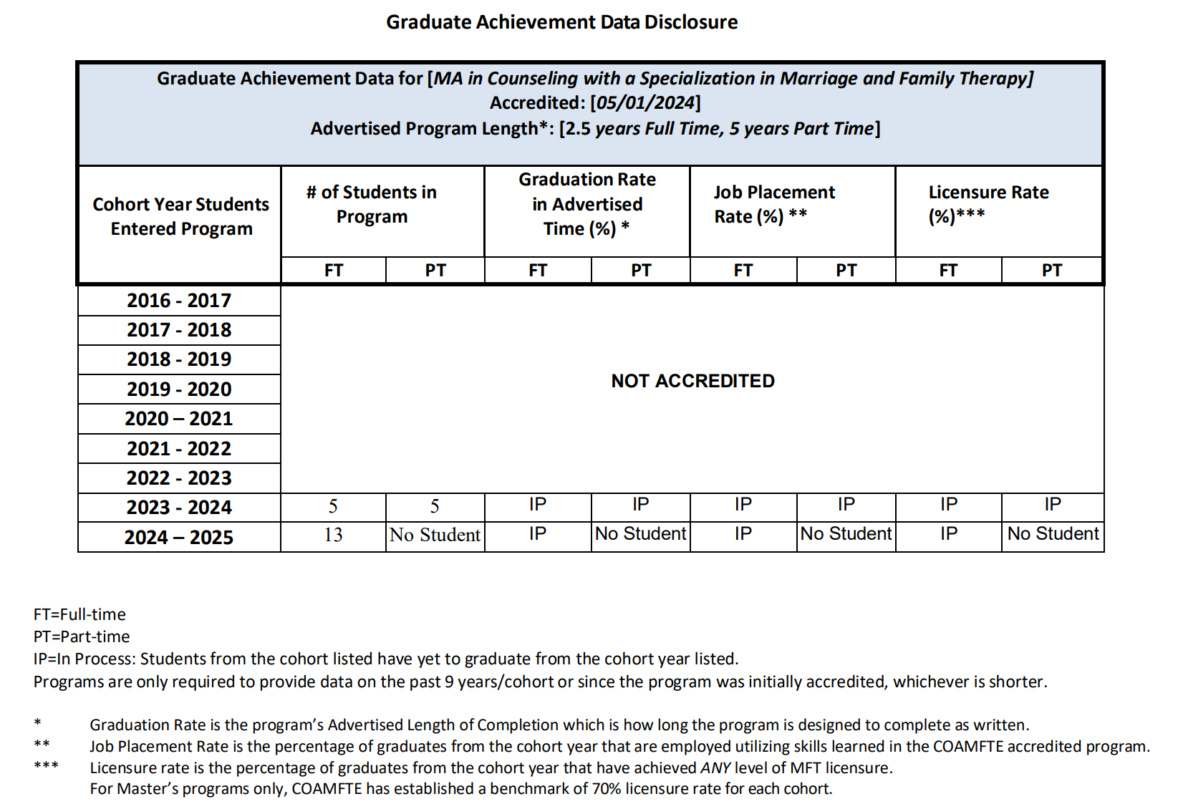
Graduation Achievement Data

Slide 25
Clinical Updates
Jan. 2022 – Dec. 2022: a total of 537 therapy requests
Jan. 2023 – Dec. 2023: a total of 563 therapy requests
Jan. 2024 – Dec. 2024: a total of 519 therapy requests
Jan. 2025 – Current: a total of 134 therapy requests
Each quarter, we have around 30-35 interns at Daybreak University Couples and Family Therapy Center (CFTC), and they meet about 2-10 clients weekly.
Client Race: Asian or Pacific Islander (80%), White or Caucasian (10%), Hispanic or Latino (9%), Black or African American (1%).

Slide 26
Program Changes/Improvements MA Program
Based On COI Feedback/Input
Reviewed Student Monitoring and Progress Report.
Based on Survey Data
Will develop more asynchronous online courses so students could have more options to take courses.
Will task curriculum committee to review Trauma class and add the Suicide Prevention content.
No other changes required at this time.
Based On Graduate
Achievement Data
COAMFTE tracking licensure for benchmarking instead of National Exam Pass rate.
Eight MFT graduates achieved the Associate Marriage and Family Therapist (AMFT) credential in California and one in Virginia.
Based on SLO Data
No changes required at this time.

Slide 27
Final remarks & Next Steps
Annual Retreat slides and all the aggregated data is uploaded on our website.
Program Director will share this slide presentation with COI’s.
Program Director requests feedback about this Retreat meeting.
Eight doctoral students are currently enrolled in the MFT program in the United States. The Daybreak Ph.D. MFT Program plans to pursue COAMFTE accreditation by submitting its Eligibility Application in Fall 2025 or Spring 2026.

Slide 28
Thank You for participating in our 2025 Annual Retreat for MA MFT Program.

