Slide 1

Daybreak University Annual Retreat for COAMFTE Program April 23, 2026
MA and PhD in Counseling
with a Specialization in
Marriage and Family Therapy

Slide 2
Agenda for Today
Welcome & Check-in
Program Updates & Accreditation Status
Program Mission
Program Goals
Student Learning Outcomes Aggregated Data
2025 Survey Aggregated Data
Program Changes & Improvements
Graduation Achievement Data
Clinical Updates
Final Remark

Slide 3
Welcome & Check-in
Welcome to our Annual MFT Retreat
Check in
Communities of Interest (COI’s)
Administrators
Faculty(Core and Adjunct Faculty)
Program Clinical Supervisors
Students
Graduates
Staff

Slide 4
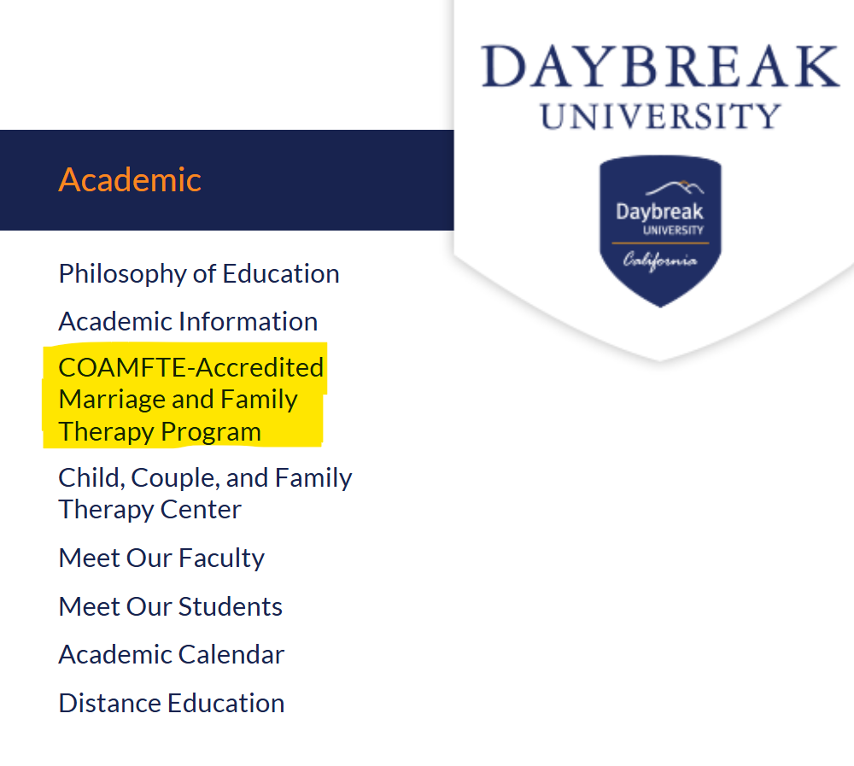
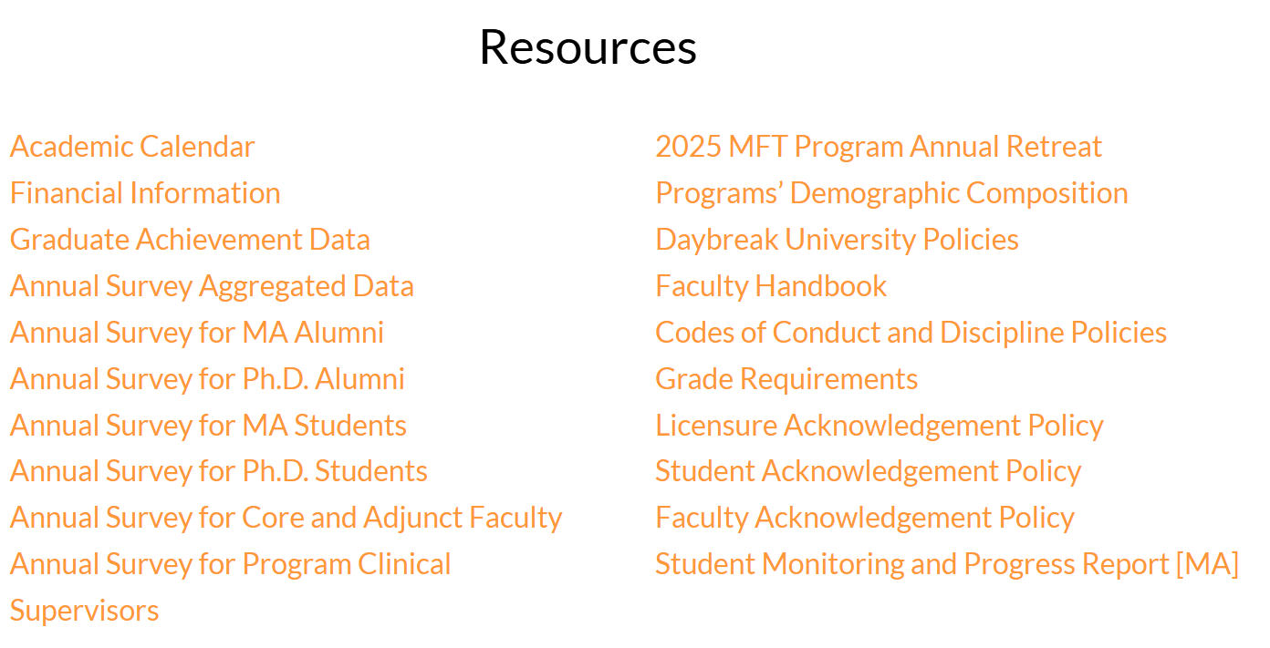
Program Updates & Accreditation Status
2025 Annual Surveys are updated on the website. https://daybreak.edu/academic/MFTprogram.html
2024 Fall COAMFTE Meeting Decision:
Daybreak university M.A. MFT Program received
the Full Accreditation given until 2029.

Slide 5
MA Program Mission and Program Goals (PG’s)
Mission: The mission of the MA Program in Counseling with a Specialization in Marriage and Family Therapy at Daybreak University is to prepare students to be culturally competent, ethical, evidence-based, self-observing, and systemic marriage and family therapists.
PG# 1 (Knowledge): The program will train students who demonstrate a foundational knowledge of marriage and family therapy theories, models, and interventions.
PG#2 (Practice): The program will train students who demonstrate a foundational competence to practice marriage and family therapy.
PG #3 (Diversity): The program will train students to practice MFT from a self-reflective and cultural competence foundation with a variety of diverse clients.
PG #4 (Ethics): The program will train students who demonstrate competencies related to legal and professional ethics, standards of practice, and personal awareness in their clinical work.
PG #5 (Research): The program will train family therapists who can consume and contribute to research in the field of marriage and family therapy.

Slide 6
MA Program Goals (PG’s), Student Learning Outcomes (SLO’s), Targets & Measure
PG# 1 (Knowledge): The program will train students who demonstrate a foundational knowledge of marriage and family therapy theories, models, and interventions.
(COAMFTE Developmental Competency Component: Knowledge of the field)
Curriculum Alignment:
1. CFT 6010: Foundations of Marriage
and Family Therapy
2. CFT 7000: Counseling and
Psychotherapeutic Theories and
Techniques: IPCST
SLO # 1:(Knowledge): Students will demonstrate comprehensive knowledge of systems theory concepts and MFT models and techniques.
At least 80% of students will pass Part I of the Comprehensive Exam
Aggregated Data for 2025: Total of 7 students (100%) passed part II of the Comprehensive Exam
Target, Measure, Data
Targe Met

Slide 7
MA Program Goals (PG’s), Student Learning Outcomes (SLO’s), Targets & Measure
PG#2 (Practice): The program will train students who demonstrate a foundational competence to practice marriage and family therapy.
(COAMFTE Developmental Competency Component: Practice)
Curriculum Alignment: CFT 7900: Practicum in Couples and Family Therapy
SLO #2 (Practice): Students will demonstrate competence in systemic/relational assessment, treatment planning, interventions, transfer, and termination.
Target, Measure, Data
Aggregated Data for 2025: Total of 7 students (100%) passed part III of the Comprehensive Exam
At least 80% of students will pass Part III of the Comprehensive Exam.
Target Met

Slide 8
MA Program Goals (PG’s), Student Learning Outcomes (SLO’s), Targets & Measure
SLO #3. (Diversity): Students will demonstrate human diversity and practice culturally-sensitive analysis and critical self-awareness when working with a diversity of individuals, couples, and families.
Target, Measure, & Data
Aggregated Data for 2025: Total of 7 students (100%) passed part II of the Comprehensive Exam
At least 80% of students will pass Part II of the Comprehensive Exam.
Target Met
PG#3 (Diversity): The program will train students to practice MFT from a self-reflective and cultural competence foundation with a variety of diverse clients
(COAMFTE Developmental Competency Component: Diversity)
Curriculum Alignment:
CFT 6300: Diversity and Multicultural
Counseling

Slide 9
MA Program Goals (PG’s), Student Learning Outcomes (SLO’s), Targets & Measure
SLO #4: (Ethics): Students will demonstrate ethical decision-making, case management, professionalism, and self-awareness in clinical practice
At least 80% of students will score a B or higher in the main assignment in the CFT 6600: Law, Professional Ethics, and Community Practice and Teletherapy course.
Aggregated Data for 2025: 100 % of students score a B or higher in the main assignment in the CFT 6600.
Target, Measure, & Data
Target Met
PG#4 (Ethics): The program will train students who demonstrate competencies related to legal and professional ethics, standards of practice, and personal awareness in their clinical work.
(COAMFTE Developmental Competency Component: Ethics)
Curriculum Alignment:
CFT 6600: Law, Professional Ethics,
and Community Practice and
Teletherapy

Slide 10
MA Program Goals (PG’s), Student Learning Outcomes (SLO’s), Targets & Measure
SLO #5: (Research): Students will be able to read and critically evaluate research for evidence - based application in the practice of marriage and family therapy.
Target, Measure, & Data
At least 80% of students will pass Part IV of the Comprehensive Exam.
Aggregated Data for 2025: Total of 7 students (100%) passed part IV of the Comprehensive Exam.
Target Met
PG#5. (Research): The program will train family therapists who can consume and contribute to research in the field of marriage and family therapy.
(COAMFTE Developmental Competency Component: Knowledge of the field)
Curriculum Alignment:
CFT 6050: Clinical Research and
Evaluation

Slide 11
Ph.D. MFT Program Mission and Program Goals (PG’s)
Mission: The mission of the PhD Program in Counseling with a Specialization in Marriage and Family Therapy at Daybreak University is to develop scientist-practitioners in the field of couple, marriage, and family therapy. The doctoral program provides academic and clinical training for the purpose of developing scholars with the competence in systemic clinical work, supervision, teaching, and research.
PG# 1 (Knowledge): The program will train students who demonstrate advanced and comprehensive knowledge of systems concepts and MFT theories and techniques.
PG#2 (Practice): The program will train students who demonstrate an ability to conceptualize systemic thinking as applied in supervision, mentoring, and the isomorphic dynamics among different levels of the training system
PG #3 (Diversity): The program will train students who demonstrate awareness and competence in culturally sensitive clinical work, supervision, teaching, and research
PG #4 (Ethics): The program will train students who demonstrate applied knowledge of MFT legal and ethical guidelines and professional standards.
PG #5 (Research):The program will train students who demonstrate the ability to design, conduct, analyze, and identify clinical implications of systemic and relational research.

Slide 12
PhD Program Goals (PG’s), Student Learning Outcomes (SLO’s), Targets & Measure
SLO #1 (Knowledge): Students will demonstrate competence in advanced MFT models and techniques.
Target, Measure, & Data
Aggregated data 2025: 2 Students (100%) scored 3 or above on section1 on the Theory of Change Paper in the Comprehensive Portfolio.
Target Met
PG# 1 (Knowledge): The program will train students who demonstrate advanced and comprehensive knowledge of systems concepts and MFT theories and techniques.
(COAMFTE Developmental Competency Component: Knowledge of the field)

Slide 13
Ph.D. Program: PG #2
PG# 2 (Practice): The program will train students who demonstrate an ability to conceptualize systemic thinking as applied in supervision, mentoring, and the isomorphic dynamics among different levels of the training system.
(COAMFTE Developmental Competency Component: Practice)
SLO#2 (Practice): Students will demonstrate the ability to integrate systems concepts and MFT theories in their clinical work, supervision, teaching, and research.
Targets, Measures, & Data:
(Clinical work) At least 80% of students will score a 3 or better on the end of term practicum evaluation question 10 (Ability to articulate theoretical and conceptual issues related to cases presented including systemic problem assessment) in the course CFT7900: Practicum in Marriage and Family Therapy.
(Supervision) At least 80% of students will score 3 points or above (satisfactory or above) on section 1 on the Philosophy of Supervision Paper in the Comprehensive Portfolio.
There are 2 student who completed the Comprehensive Portfolio in 2025.
(Teaching) At least 80% of students will score 3 points or above (satisfactory or above) on section 1 on the Teaching Philosophy Paper in the Comprehensive Portfolio.
There are 2 student who completed the Comprehensive Portfolio in 2025.
(Research) At least 80% of students will score 3 points or above (satisfactory or above) on sections 1 on the Publishable Research Paper in the Comprehensive Portfolio.
There are 2 student who completed the Comprehensive Portfolio in 2025.

Slide 14
Ph.D. Program: PG #3
PG# 3(Diversity): The program will train students who demonstrate awareness and competence in culturally sensitive clinical work, supervision, teaching, and research.
(Developmental Competency Component: Diversity)
SLO #3 (Diversity): Students will demonstrate understanding of contextual factors and respect for diversity and inclusion in their clinical work, supervision, teaching, and research.
Targets, Measures, & Data:
(Clinical work) At least 80% of students will score a 3 or above (satisfactory or above) on section 3 of the Theory of Change Paper in the Comprehensive Portfolio.
2025 Data: 2 out of 2 students scored a 3 or above in the Comprehensive Portfolio: Target Met
(Supervision) At least 80% of students will score 3 points or above (satisfactory or above) on section 2 on the Philosophy of Supervision Paper in the Comprehensive Portfolio.
2025 Data: 2 out of 2 students scored a 3 or above in the Comprehensive Portfolio: Target Met
(Teaching) At least 80% of students will score 3 points or above (satisfactory or above) on section 2 on the Teaching Philosophy paper in the Comprehensive Portfolio.
2025 Data: 2 out of 2 students scored a 3 or above in the Comprehensive Portfolio: Target Met
(Research) At least 80% of students will score 3 points or above (satisfactory or above) on sections 3 on the Publishable Research Paper in the Comprehensive Portfolio.
2025 Data: 2 out of 2 students scored a 3 or above in the Comprehensive Portfolio: Target Met

Slide 15
Ph.D. Program: PG #4
PG #4(Ethics): The program will train students who demonstrate applied knowledge of MFT legal and ethical guidelines and professional standards.
(Developmental Competency Component: Ethics)
SLO #4 (Ethics): Students will demonstrate potential competence in ethical and professional clinical work, supervision, teaching, and research.
Targets, Measures, & Data:
(Clinical work) At least 80% of students will score a B or higher in the main assignment in the CFT 8600: Law, Professional Ethics,
and Community Practice and Teletherapy course
Aggregated Data for 2025: 100 % of students score a B or higher in the main assignment in the 8600: Target Met
(Clinical work) At least 80% of students will score a 3 or above (satisfactory or above) on section 4 of the Theory of Change Paper in the Comprehensive Portfolio. There is no student who completed the Comprehensive Portfolio in 2023.
(Supervision) At least 80% of students will score 3 points or above (satisfactory or above) on section 3 on the Philosophy of Supervision Paper in the Comprehensive Portfolio.
Aggregated Data for 2025: 100 % of students score a B or higher in the main assignment in the 8600: Target Met
(Teaching) At least 80% of students will score 3 points or above (satisfactory or above) on section 3 on the Teaching Philosophy paper in the Comprehensive Portfolio.
(Research) At least 80% of students will score 3 points or above (satisfactory or above) on sections 5 on the Publishable Research Paper in the Comprehensive Portfolio.

Slide 16
PhD Program Goals (PG’s), Student Learning Outcomes (SLO’s), Targets & Measure
SLO #5 (Research): Students will demonstrate the ability to conduct systemic and relational research that has clinical implications for marriage and family therapy
Targets, Measures, & Data
At least 80% of students will score 3 or above (satisfactory or above) on section 4 of the Publishable Research Paper of the Comprehensive portfolio.
Aggregated data 2025: 2 Students (100%) scored 3 or above on section 4 of the Publishable Research Paper of the Comprehensive portfolio.
Target met
PG# 5 (Research): The program will train students who demonstrate the ability to design, conduct, analyze, and identify clinical implications of systemic and relational research
(COAMFTE Developmental Competency Component: Research)

Slide 17
2025 Survey Feedback: MA Program Mission, PG’s, SLO’s
Good materials and coverage of content
I agree with the program goals and student learning outcomes
Still think these are solid.
I am completely satisfied with the program's missions, goals and the student learning outcomes.
I am confident that this school's MFT Program's Mission, Program Goals, and Student Learning Outcomes will effectively apply the education, clinical practice, and research necessary to become an LMFT and achieve the best results.

Slide 18
2025 Survey Feedback: Ph.D. Program Mission, PG’s, SLO’s
Very well organized program. But Doctor’s Program need more communication with professors individually.
Through continuous guidance, I will demonstrate the students' competence in marriage and family therapy.
I am satisfied.

Slide 19
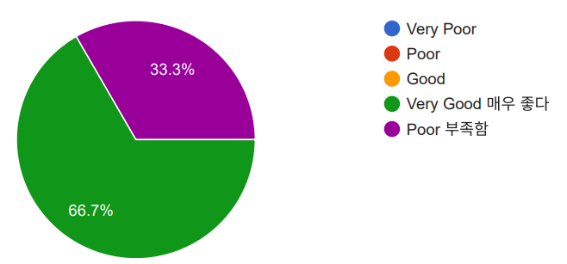
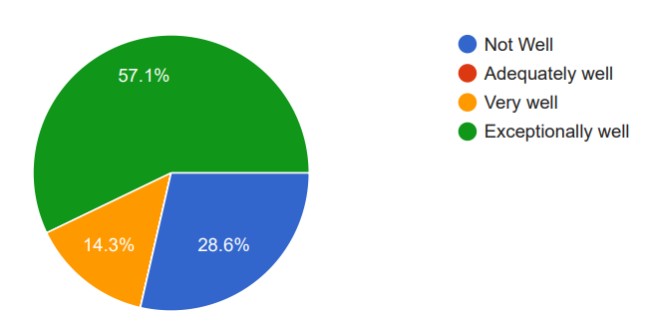
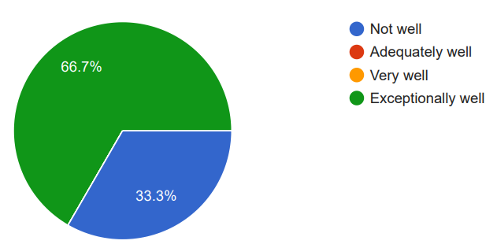
2025 Survey Feedback: MA Program Diverse and Inclusive Learning Environment
Aggregated Data
Students:
Faculty:
Supervisors:
There were no physical or technical resources.
Access to printers and the library was restricted.
Need more diverse supervision.

Slide 20
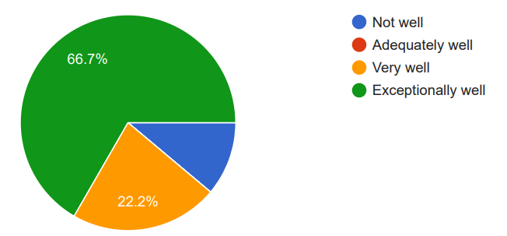
2025 Survey Feedback: Ph.D. Program Diverse and Inclusive Learning Environment
Aggregated Data
Students:
Faculty:
Supervisors:
There were no physical or technical resources.
Access to printers and the library was restricted.
Need more diverse supervision.

Slide 21
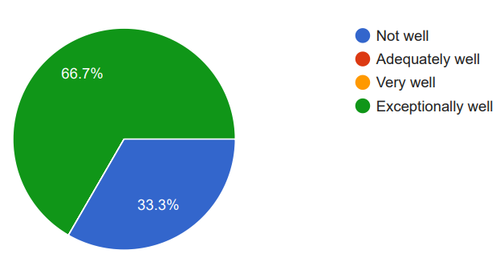
2025 Survey Feedback: MA Program Diverse and Inclusive Learning Environment
There were no physical or technical resources.
Access to printers and the library was restricted.
More diverse supervision
Aggregated Data
Students:
Supervisors:

Slide 22
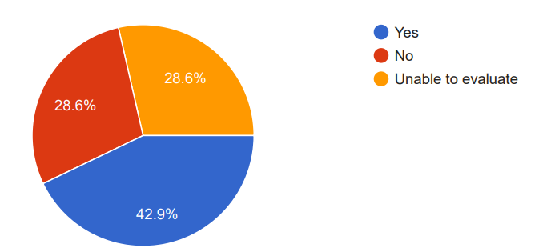
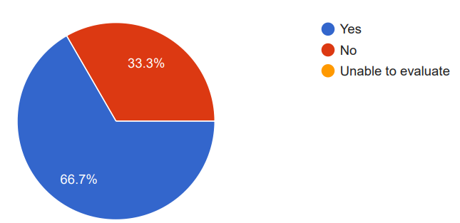
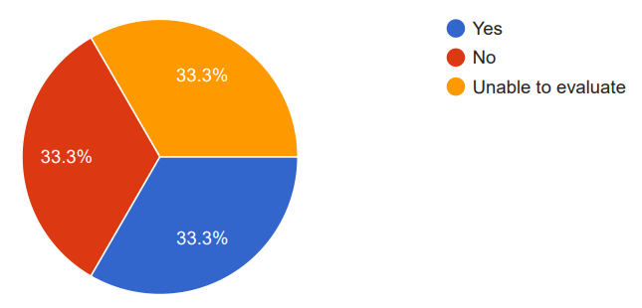
2025 Survey Data: Faculty, Program Clinical Supervisor, & Staff Sufficiency
Faculty:
Program Clinical Supervisors:
Staff:

Slide 23
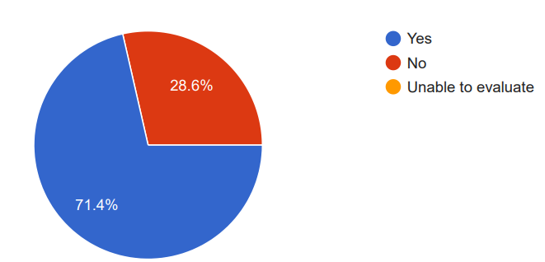
2025 Survey Data: MA Program Environmental Supports
Asked about the following:
Library
Classroom
Technology
Student Support Services
Student Counseling
Student Advising
Staff Sufficiency
Clinic
Fiscal resources
Computer Facilities
Rated all Environmental Supports as Sufficient:

Slide 24
2025 Survey Data: Curriculum Feedback
MA Program
The classes lacked variety. There were many pre-recorded lectures, and it was disappointing
Academic courses are great
The summer intensives were excellent.
I think that students need to be able to go through their practicum experience as a cohort so that there is less variability in clinical developmental levels and skills.
The program needs to do more to ensure there are adequate clients for the student therapists to be able to fulfill their clinical experience hours while under faculty supervision.
I am really comfortable with the classes I taught and the curriculum that we used.
PhD Program
I’ve had many wonderful experiences and learned a lot so far.
The program features a robust curriculum that is well-suited for mastering both academic theory and clinical practice. It also incorporates a supervision component designed to facilitate the acquisition of more advanced practical skills. However, I currently feel somewhat at a loss regarding the process of conducting research and writing my degree thesis; I would greatly appreciate more diverse and specific forms of support in this area.

Slide 25
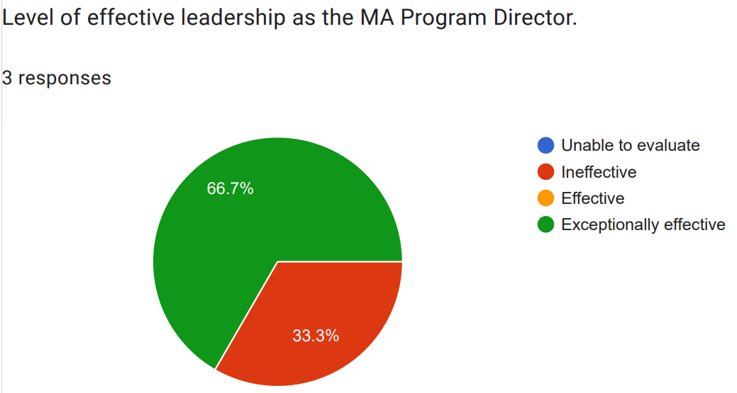
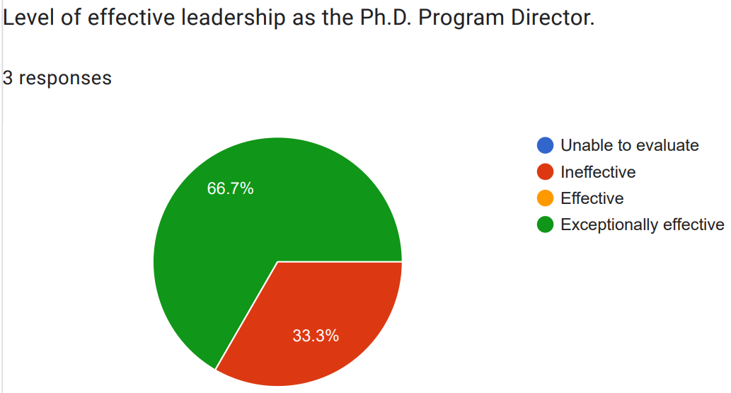
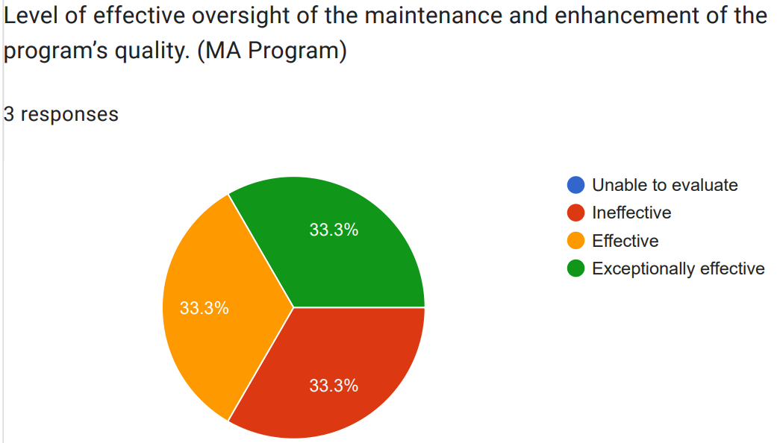
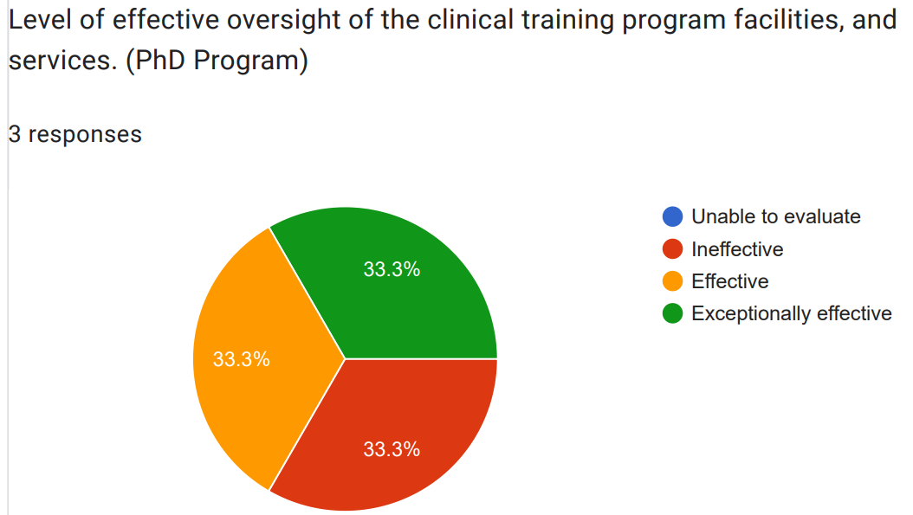
2025 Survey Data: Faculty, Program Clinical Supervisor and Program Director Effectiveness

Slide 26
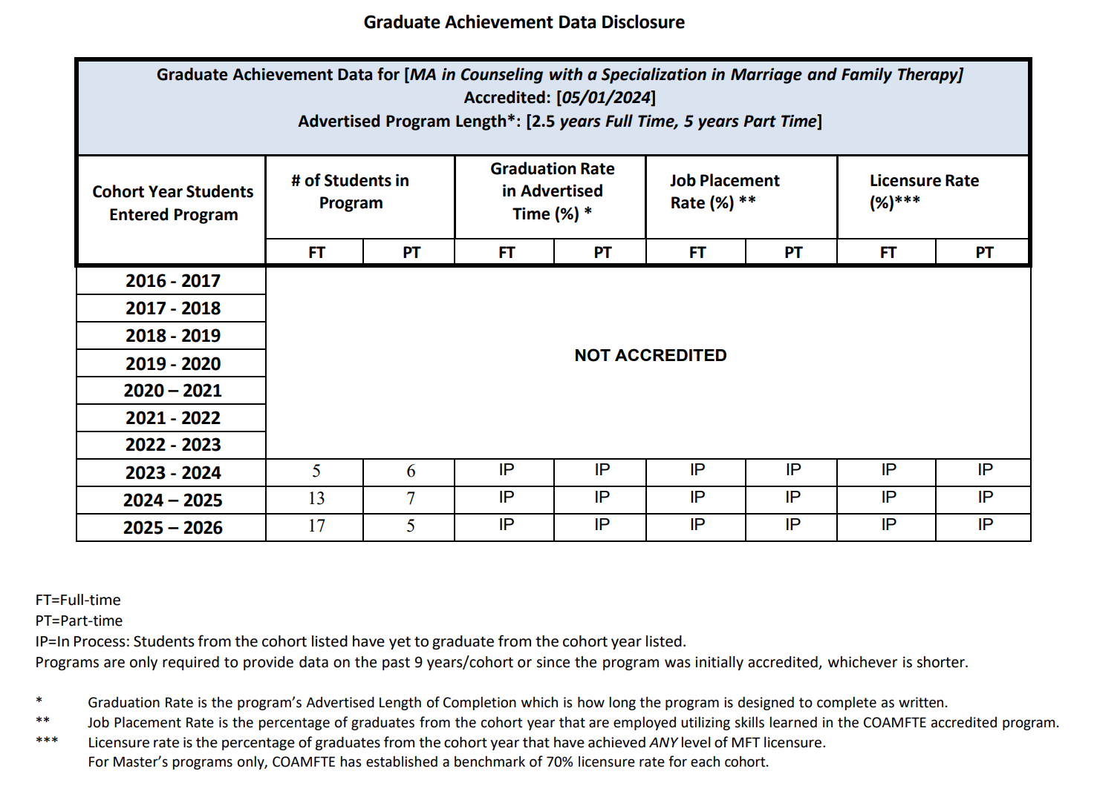
Graduation Achievement Data

Slide 27
CFCC & CFTC Clinical Updates
Jan. 2022 – Dec. 2022: a total of 537 therapy requests
Jan. 2023 – Dec. 2023: a total of 563 therapy requests
Jan. 2024 – Dec. 2024: a total of 519 therapy requests
Jan. 2025 – Dec. 2025: a total of 100 therapy requests (CA Clients Only)
In 2025 Academic year, we had around 28 interns at Daybreak University Couples and Family Therapy Center (CFCC & CFTC), and they met about 2-10 clients weekly.
CFCC Client Race: Asian 80%, White 10%, Hispanic/Latino 9%, Black or African American 1%, Middle Eastern 0%, Multiracial 0%, and Unreported 0%
CFTC Client Race: Asian 35%, White 26%, Hispanic/Latino 12%, Black or African American 5% , Middle Eastern 4%, Multiracial 7% , and Unreported 11%.

Slide 28
Program Changes/Improvements MA Program
Based On COI Feedback/Input
Reviewed Student Monitoring and Progress Report.
Based on Survey Data
In the process of developing more asynchronous online courses so students could have more options to take courses.
Curriculum committee reviewed Trauma class and added the Suicide Prevention content.
Have diverse supervisors for 7900.
Have more environment resources, accessible library, ebook, technology, etc.
Based On Graduate Achievement Data
COAMFTE tracking licensure for benchmarking instead of National Exam Pass rate.
10 MFT graduates achieved the Associate Marriage and Family Therapist (AMFT) in California and in other State.
Based on SLO Data
No changes required at this time.

Slide 29
Final remarks & Next Steps
Annual Retreat slides and all the aggregated data is uploaded on our website under MFT Program
Program Director will share this slide presentation with COI’s.
Program Director requests feedback about this Retreat meeting.
Special Lecture by Dr. Harville and Dr. Helen recorded link will be sent via email today.

Slide 30
Thank You for participating in 2026 Annual Retreat for MA MFT Program

